Slide 1
SUPERMARKET BILLING SYSTEM
ESFP-II PROJECT

Slide 2
OUR AIM FOR THE PROJECT→
OUR AIM TO BUILD THIS PROJECT IS TO MANAGE THE BILLING SYSTEM FOR OUR CUSTOMER IN A STRUCTURED FORMAT , USING FILES AND ALSO AT THE SAME TIME ENSURING SECURITY.

Slide 3
THE FUNCTIONS IN THE WHOLE PROJECT ARE → 1) ADD DATA 2) REMOVE DATA 3) EDIT DATA 4) FIND DATA 5) SHOW DATA 6) SAVE DATA 7) list

Slide 4
HEADER FILES USED IN THE PROJECT→
#include<iostream>
#include<cstdio>
#include<cstdlib>
#include<cstring>
#include<conio.h>
#include<windows.h>
#include<fstream>
#include<iomanip>

Slide 5
CONCEPTSof c++ language used
1. Class and Objectives.
2. Functions.
3. Structures.
4. File handling.

Slide 6
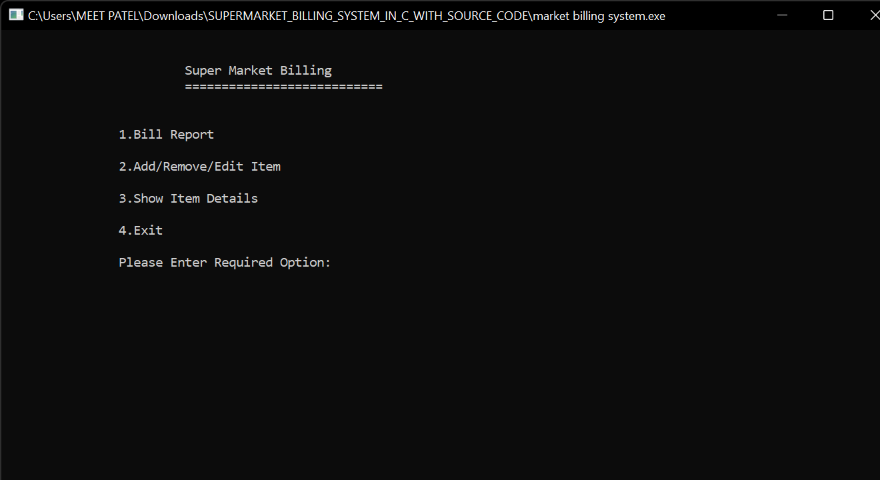
BELOW IS THE EXECUTION OF THE PROGRAM AND FLOW OF THE PROGRAM →
1) AT THE START THE PROGRAM WILL TELL US TO PRESS ANY KEY WE WISH TO PRESS FOR THE NEXT FUNCTIONS TO PERFORM.
2)THEN IT WILL SHOW US A BUFFERING TIME OF UPTO 3 SECONDS TILL THE MAIN PAGE SHOWS UPS.
3)FINALLY THE MAIN PAGE WILL SHOW UP WITH ALL THE OPERATION THAT COULD BE PERFORMED BY THE BUILT SOFTWARE.

Slide 7
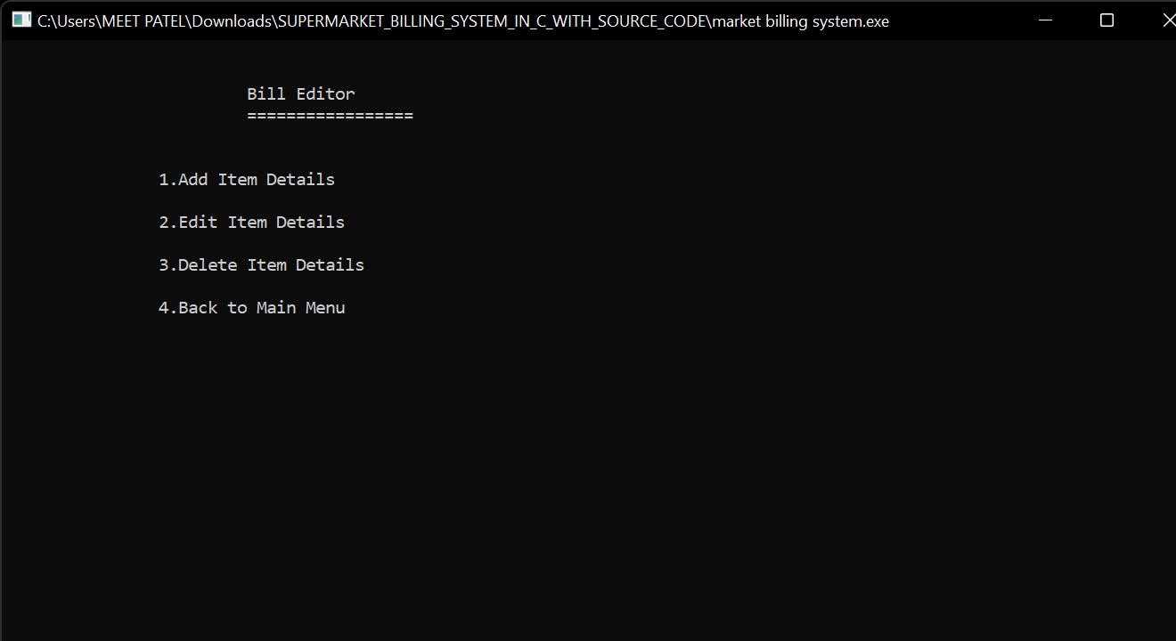

Slide 8
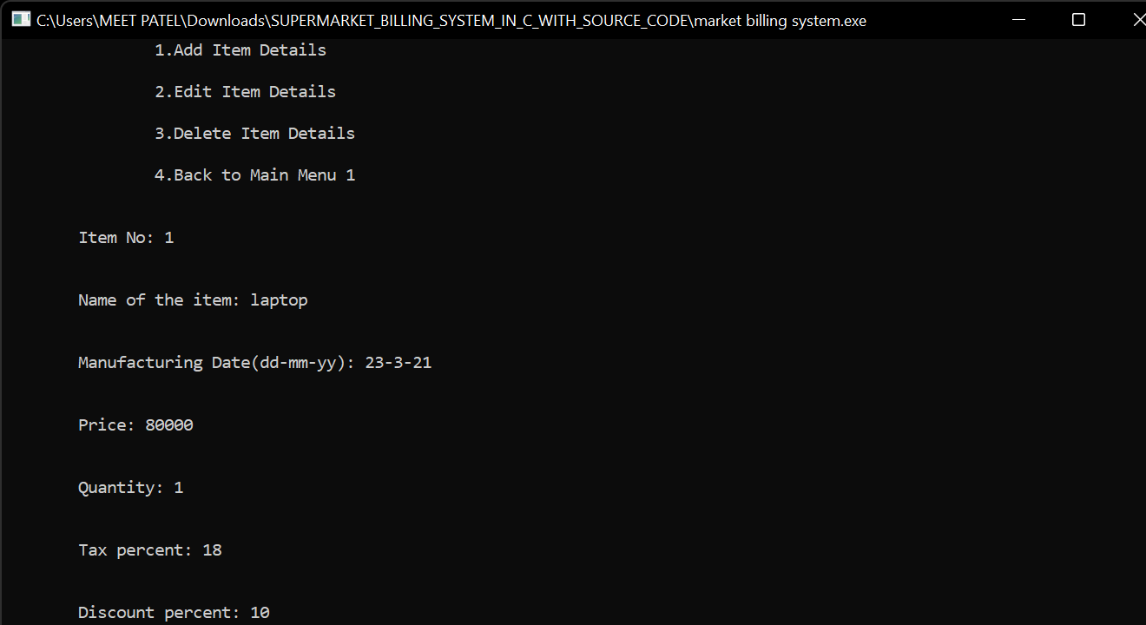

Slide 9


Slide 10
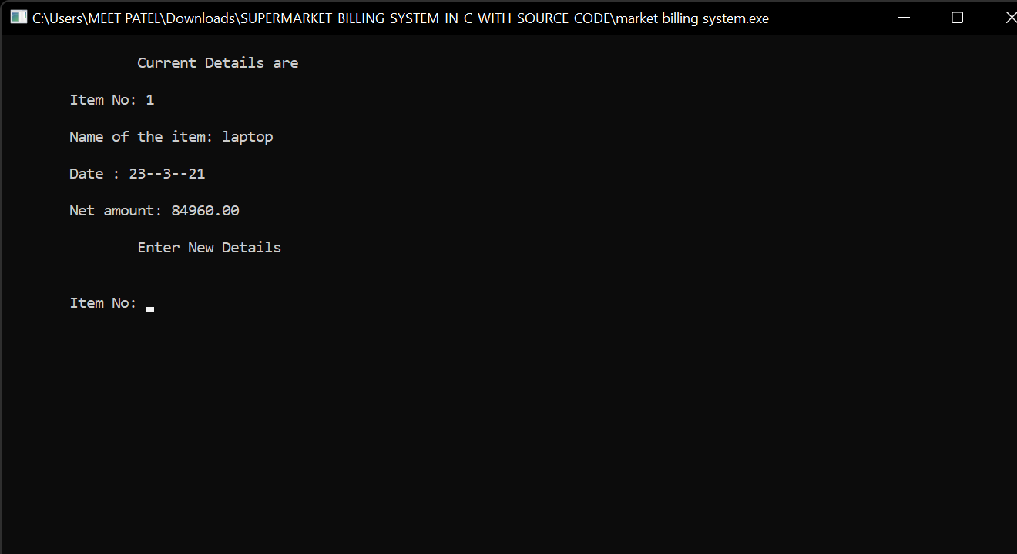

Slide 11
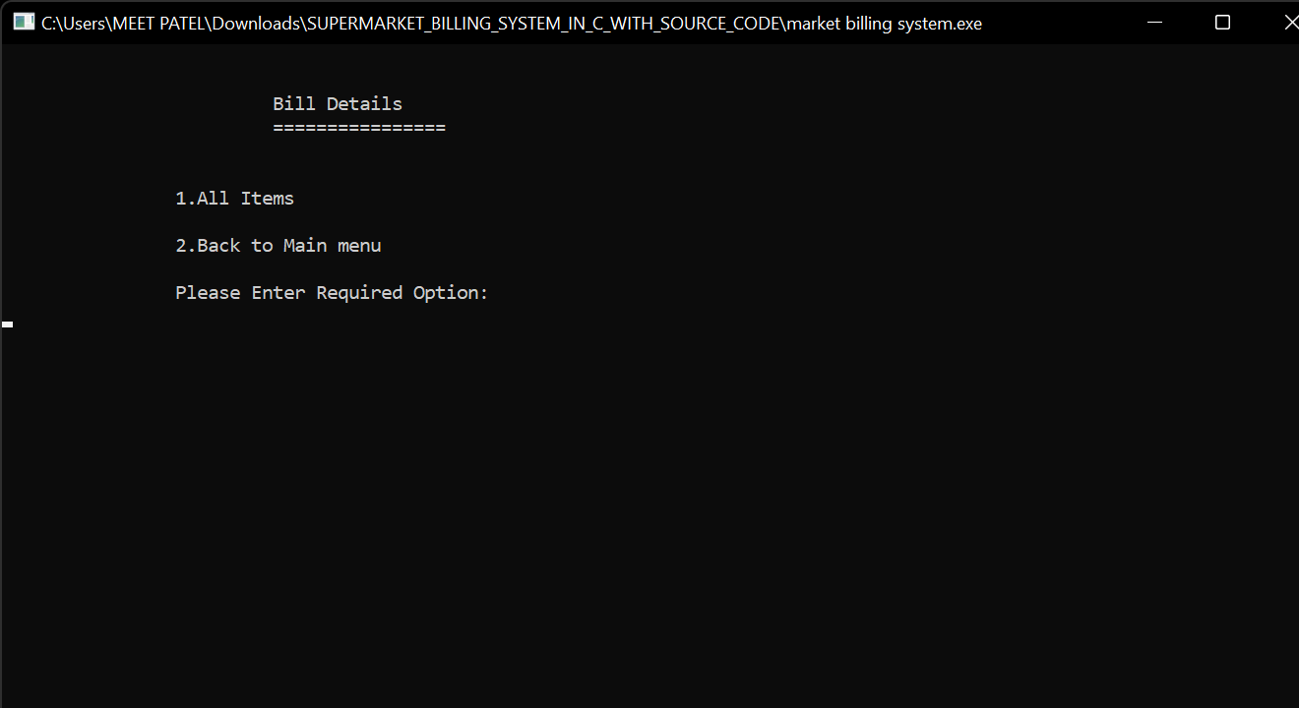

Slide 12
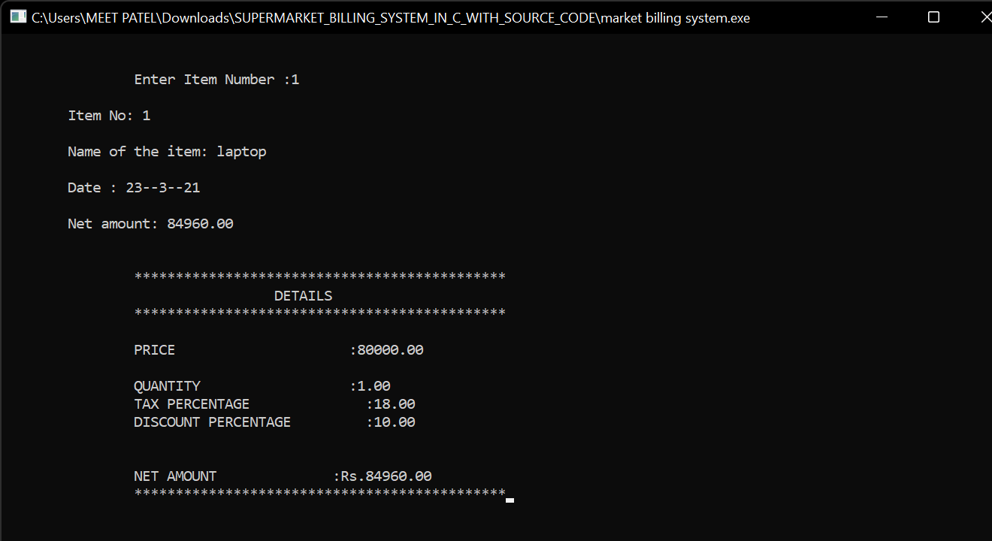

Slide 13


Slide 14
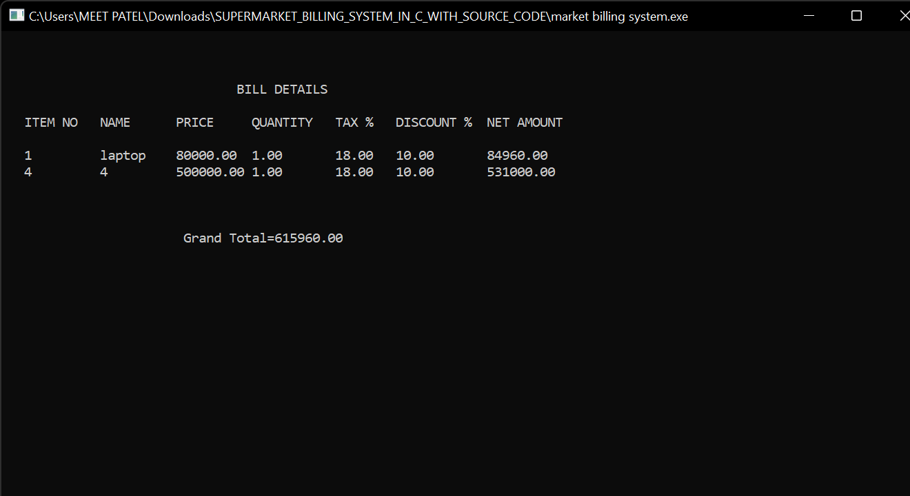

Slide 15
THANK YOU
-SHIVAM PATEL
ENROLLMENT NO. → 21162101019

